Slide 1
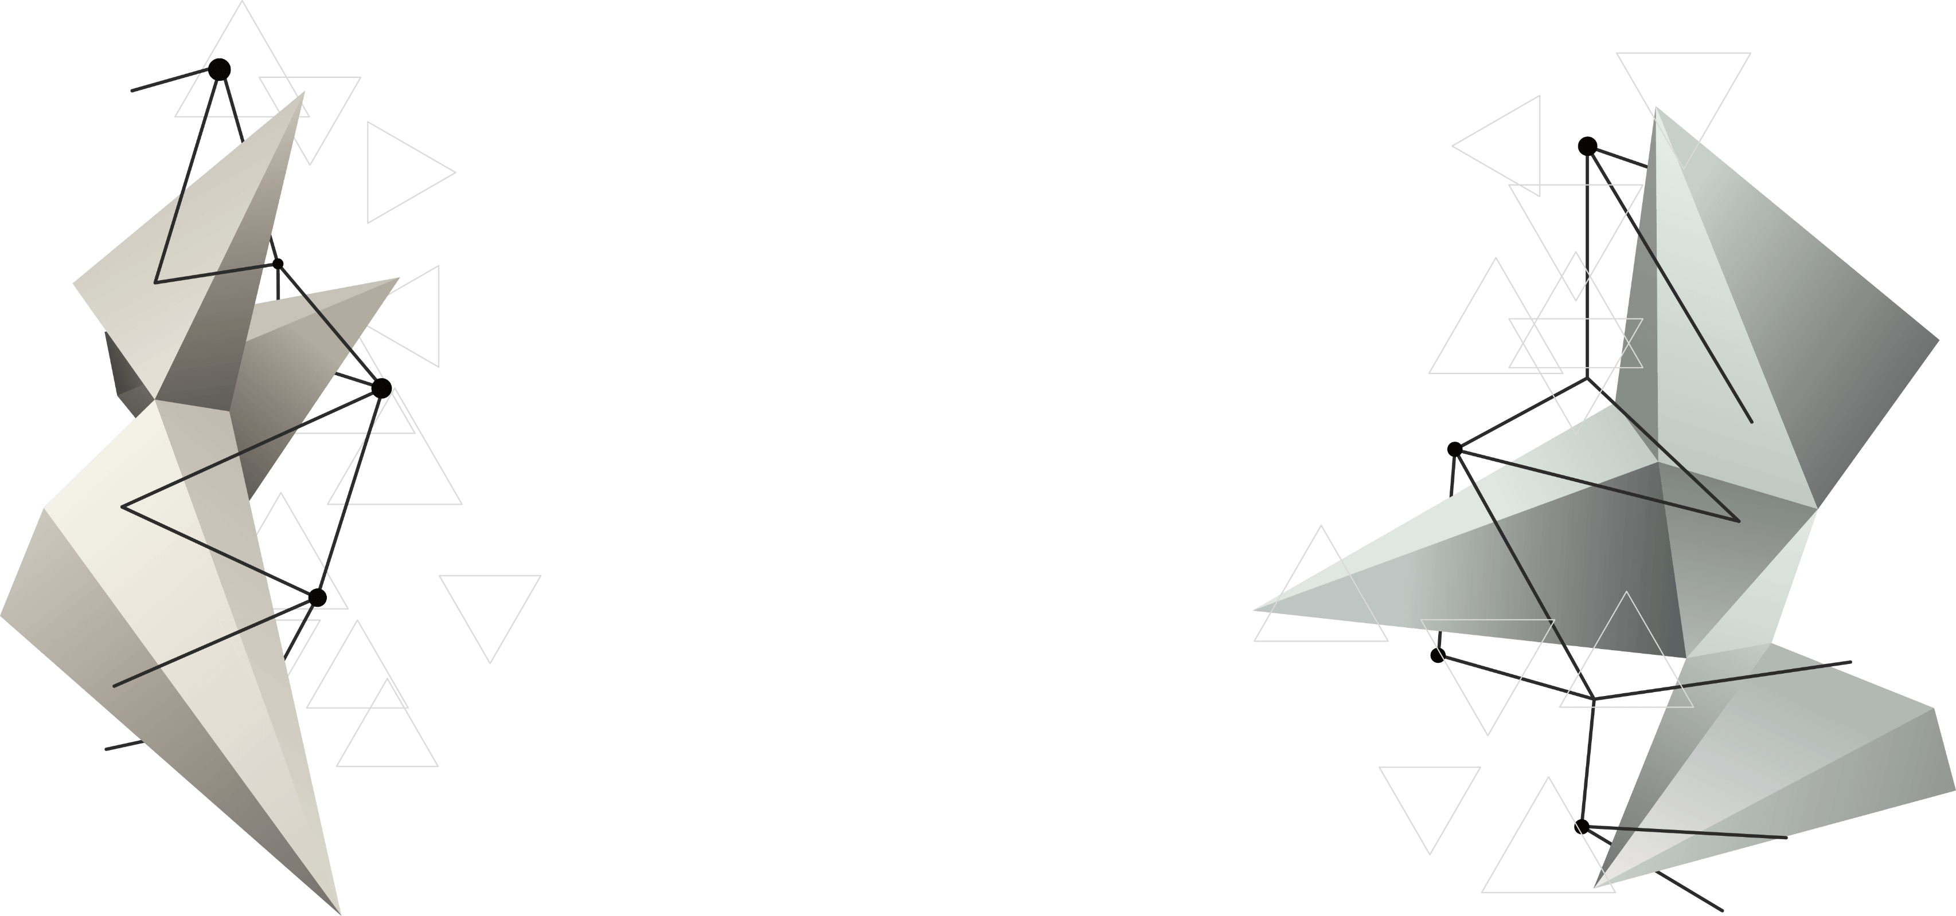

CAP 5738 - Data Visualization - Spring 2018
Paper Presentation
Narrative Visualization: Telling stories with data
Authors: Edward Segel and Jeffrey Heer
IEEE transactions on visualization and computer graphics 16.6 (2010): 1139-1148
Present by: Li Li and Yezehao Huai

Slide 2


Jeffrey Heer is an Associate Professor of Computer Science & Engineering at the University of Washington, where he directs the Interactive Data Lab and conducts research on data visualization, human-computer interaction and social computing. The visualization tools developed by Jeff and his collaborators (Vega, D3.js, Protovis, Prefuse) are used by researchers, companies, and thousands of data enthusiasts around the world.
Jeff's research papers have received awards at the premier venues in Human-Computer Interaction and Visualization (ACM CHI, ACM UIST, IEEE InfoVis, IEEE VAST, EuroVis). Other honors include MIT Technology Review's TR35 (2009), a Sloan Fellowship (2012), an Allen Distinguished Investigator Award (2014), a Moore Foundation Data-Driven Discovery Investigator Award (2014), and the ACM Grace Murray Hopper Award (2016).
Jeff holds B.S., M.S., and Ph.D. degrees in Computer Science from UC Berkeley, whom he then betrayed to join the Stanford faculty (2009–2013). He is also a co-founder of Trifacta, a provider of interactive tools for scalable data transformation.
Edward Segel has always worked at the intersection of product strategy, analytics, and design. In his current role as SVP Business, he is responsible for new product lines, competitive intelligence, and customer insights. Part of Oscar's founding team, he served as VP Product for the company’s first four years leading digital products and design. Previously he did economic research at hedge fund Bridgewater Associates and data visualization consulting at Bloomberg LP. He holds an undergraduate degree from Harvard University, and a MS Symbolic Systems and MBA from Stanford University. Outside of work, he enjoys music, racquet sports, and the great outdoors.

Slide 3
1
Introduction

Slide 4
c
01
  Text conveys the story, and the image provides supporting evidence or related details
    Diagrams
    Charts
。
  New visualization classes attempt to combine narratives with interactive graphics
  Require skills like those familiar to movie directors, beyond a technical expert’s knowledge of computer engineering and science.
Past
Current
Use Data Tell a Good Story

Slide 5
01
Related Work
Narrative Structure
  “An account of a series of events, facts, etc., given in order and with the establishing of
  connections between them.” - Hero’s journey
  Strategies vary among media and genre - Stream of consciousness &Split screen sequences
Visual Narratives
Nuanced techniques for sequentially directing a viewer’s attention and keeping viewers oriented across transitions.
Visual salience - color, size, and orientation
Storytelling with Data Visualization
  The relationship between the two are rarely articulated clearly
  Who / What / Where / When / Why / How
  Visualization systems have begun to incorporate storytelling into their design
  -GeoTime Stories – create annotated stories within visualizations
  -Sense.us – create trails of visualization bookmarks
  -Tableau – review, collate, and export key points of their visual analysis

Slide 6
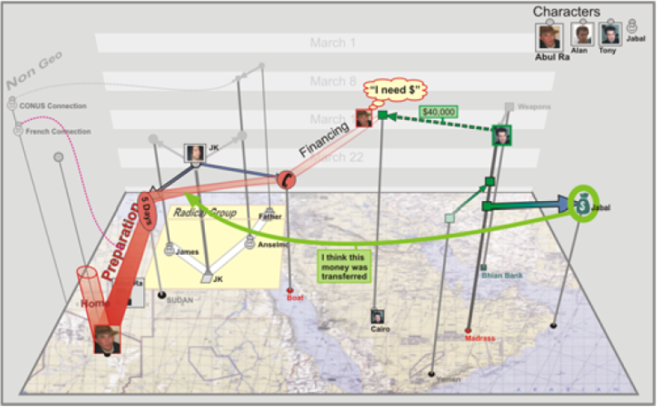
01
GeoTime Stories – create annotated stories within visualizations

Slide 7
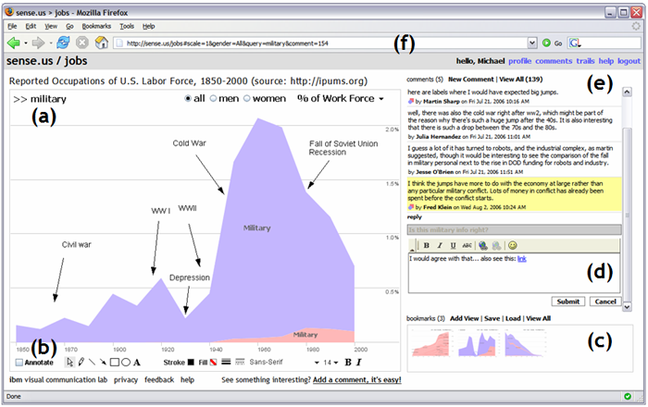
01
Sense.us – create trails of visualization bookmarks

Slide 8
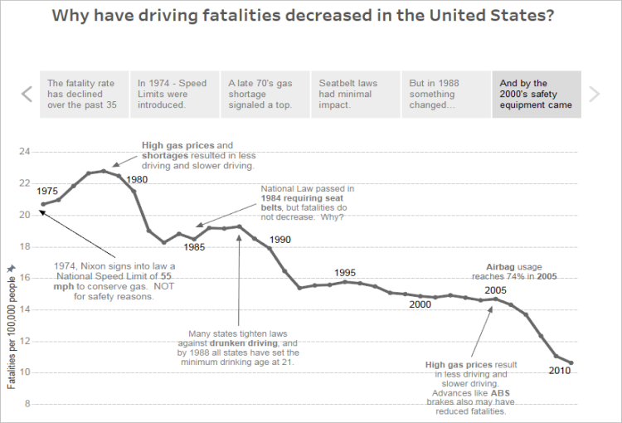
01
Tableau Storyboard – review, collate, and export key points of visual analysis

Slide 9
01
DESIGN SPACE ANALYSIS
A table that relates each example to specific design strategies observed across the dataset. In total 58 visualizations using the case study method illustrated in Section 2. The examples were taken from online journalism (71%), business (20%), and visualization research (9%).
CASE STUDIES OF NARRATIVE VISUALIZATION
Five selected case studies of Narrative
Visualization from online journalism, including visualizations produced by the New York Times, the Guardian, the Financial Times, the Washington Post, and Slate.

Slide 10
2
Case Studies of Narrative Visualization

Slide 11
1.Steroids or Not, the Pursuit is On
Annotation
Matching on content
Visual highlighting

Slide 12
2.Budget Forecasts, Compared With Reality
Progress bar
Consistent visual platform
Multi-messaging
Details-on-demand
Timeline slider
Interactive slideshow

Slide 13
3.Afghanistan: Behind the Front Line
Semantically consistent
Timeline slider
Details-on-demand
Markers of interactivity

Slide 14
4.Gapminder Human Development Trends
Checklist structure
Animated transition
Single-frame interactivity
Semantically consistent

Slide 16
5.The Minnesota Employment Explorer
Exploring
new perspectives

Slide 17
3
Design Space Analysis

Slide 18
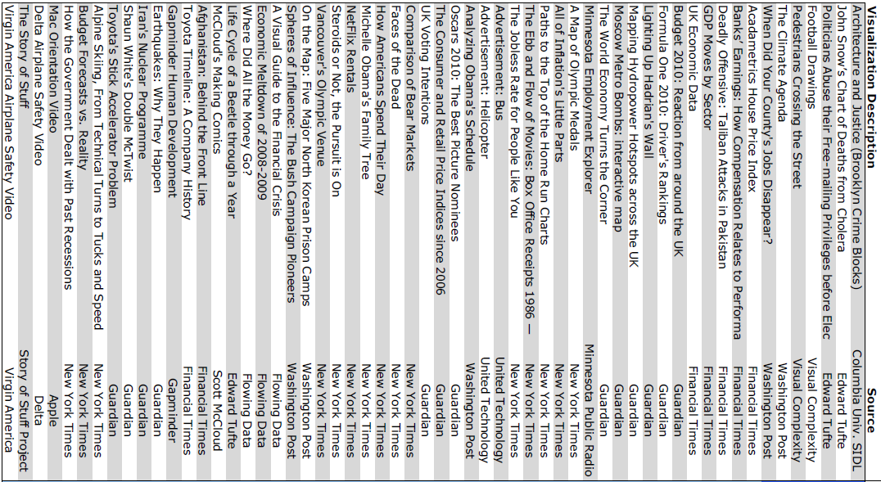
03

Slide 19
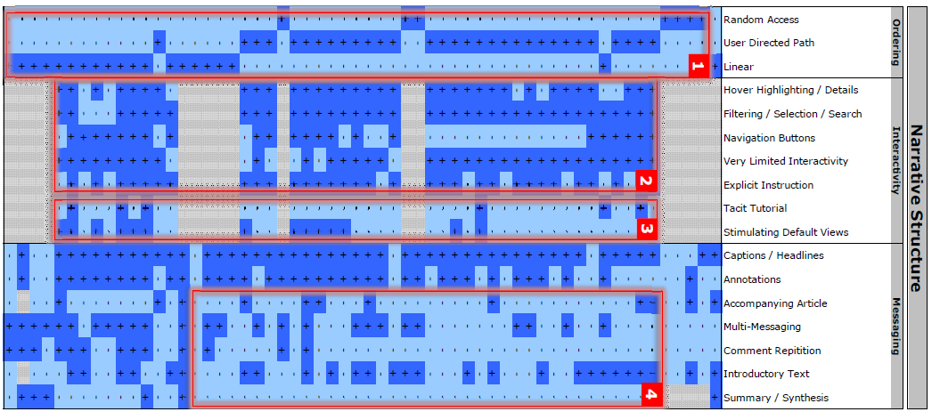
03
Design Space Observations

Slide 20
03
Genres of Narrative Visualization
Author-Driven | Reader-Driven
Linear ordering of scenes | No prescribed ordering
Heavy messaging | No messaging
No interactivity | Free interactivity

Slide 21
03
Martini Glass Structure
Begin with an author-driven approach. Then the visualization opens up to a reader-driven stage where the user is free to interactively explore the data.
Interactive Slideshow
Follows a typical slideshow format, but incorporates interaction mid- narrative within the confines of each slide
Modes
Drill-Down Story
A general theme and then allows the user to choose among particular instances of that theme to reveal additional details and backstories.

Slide 22
4
Conclusion

Slide 23
Thank You

